Slide 1
Adaptive Tic Tac Toe Game Using Reinforcement Learning
Your name

Slide 2
Introduction
Simple, classic two-player game
Objective: Align three symbols in a row
Traditional AI: Rule-based or heuristic methods
Limitations: Fixed strategy, lacks adaptability
RL Concept: Learning through trial and error
Q-Learning: A type of RL algorithm
Adaptive: Learns optimal strategies over time
Goal: Create an adaptive AI Tic Tac Toe game using Q-Learning
Focus: Improve AI performance through continuous learning

Slide 3
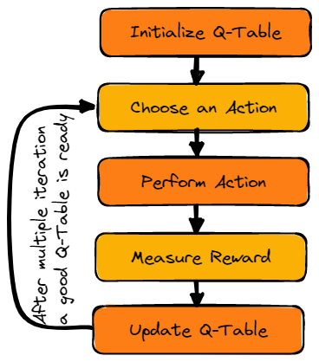
Q-learning algorithm

Slide 4
Background
Fixed strategies and rules
Predefined movesets and patterns
Lack of adaptability and learning
Ineffective against varying player strategies
Dynamic learning and adaptation
Successful implementation in complex games (e.g., AlphaGo)

Slide 5
AI Techniques
Learning through trial and error
Maximizing cumulative reward
Agent-environment interaction
Model-free RL algorithm
Q-values for state-action pairs
Learning optimal policies through experience

Slide 6
Q-learning Algorithm
Model-free RL algorithm
Learns optimal action policy
Q-table initialization
State-action-reward dynamics
Update rule: Q(s, a) ← Q(s, a) + α [r + γ max(Q(s', a')) - Q(s, a)]
Advantages: Adaptive, learns from experience
Disadvantages: Requires extensive training

Slide 7
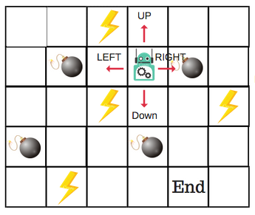
Q-Table

Slide 8
Comparison with Traditional Techniques
Differences Between RL and Rule-Based Methods:
RL: Experience-driven, dynamic adaptation
Rule-based: Predefined strategies, static behavior
Advantages of RL in Dynamic Environments:
Adapts to changing strategies
Learns optimal actions over time

Slide 9
Implementation Details
State Encoding and Reward System:
States: Board configurations
Rewards: +1 win, -1 loss, 0 draw
Data Generation Through Simulated Gameplay:
Self-play to gather data
Diverse opponent strategies
Training and Testing Phases:
Training: Iterative learning
Testing: Evaluating performancE

Slide 10
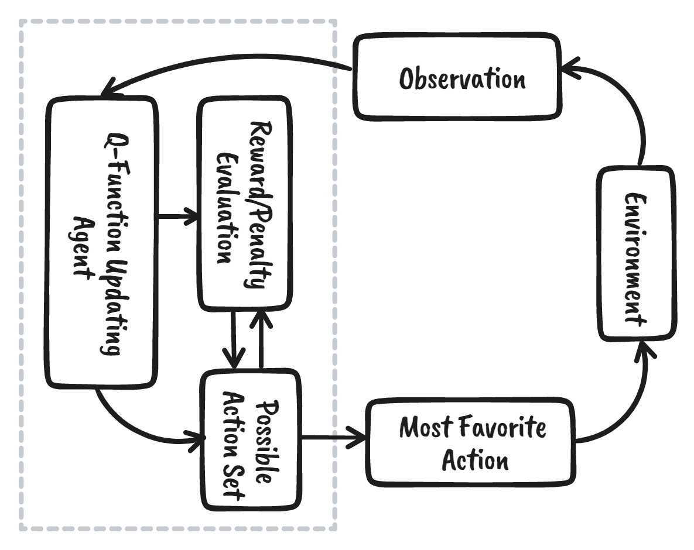
Flowchart of implementation steps of q learning

Slide 11
Evaluation Method
Criteria:
System performance, adaptability, user engagement
Experimental Setup:
Simulated gameplay
Benchmarking vs. traditional AI
Human opponents for real-world testing

Slide 12
System Performance, Adaptability Results & User Engagement Results
Win, Draw, and Loss Rates:
Metrics for different opponents
Average Game Length:
Number of moves per game
Learning Efficiency:
Speed of learning optimal strategies
Strategy Variation:
Diverse tactics employed
User Feedback on Difficulty, Enjoyment, and Perceived Intelligence:
Survey results
Engagement Duration:
Time spent playing

Slide 13
Discussion
Interpretation of Results:
Performance analysis
Strategy effectiveness
Expected vs. Actual Outcomes:
Alignment with goals
Learnings from the Experiment:
Key insights gained

Slide 14
Strengths and Weaknesses
What Went Well:
Learning curve, user engagement
What Went Poorly:
Training time, state space complexity

Slide 15
Areas for Improvement
Enhanced Learning Algorithms:
More sophisticated RL techniques
Parameter Optimization:
Fine-tuning for better performance
Multi-Agent Learning:
Cooperative and competitive learning

Slide 16
Questions & Answers
Thank you for your attention!
We are now open for questions.
Please feel free to share your feedback or suggestions.
We look forward to a productive discussion.

